Slide 1
Creativity and Innovation in Mathematics
GLA UNIVERSITY
23/01/2023
-by Ayush Tiwari, Divyanshi Soni, Tejaswini Singh Chauhan, Shiva Shrivastava and Anik Roy

Slide 2
TABLE OF CONTENTS
01
02
03
Introduction
Implementation
Examples
Understanding what the topic is and how creativity and innovation can be thought of in the field of mathematics.
Here, we will see how creativity can be applied in a mathematics classroom and how a teacher can make their class more interesting.
A set of interactive games that can be played in the class to deepen our understanding of basic mathmatics.

Slide 3
01
Introduction
GLA UNIVERSITY
23/01/2023

Slide 4
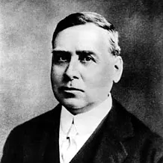
Introduction
When we think of mathematics we often assume that it is a subject that is absolute and there is only one correct answer to a mathematical problem.
Students and teachers believe that calculation and solving problem statements given in textbooks is what mathematics is all about.
However, this is all but a very small part of mathematics. The subject is still very much young and new contributions are being made to it every day. Mathematicians who can creatively utilize their minds in mathematics and make major contributions to the field are also awarded the Fields medal.

Slide 5
— Sir Andrew Wiles (proved Fermat’s last theorem)
“Creativity is what maths is all about… We’re coming up with some completely unexpected patterns, either in the reasoning or the results… We’re thinking in terms of beauty and creativity, but the outside world thinks of us like a computer”

Slide 6
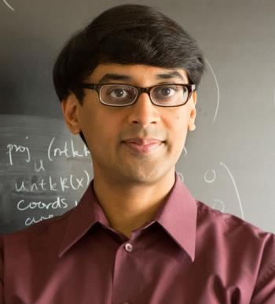
The Case of Manjul Bhargava
In 2014, a young successful mathematician by the name of Manjul Bhargava was awarded the Fields medal.
His achievement was to simplify a very complicated mathematical proof in the field of geometry of numbers from the 18th century in a very few lines
He drew inspiration from a Rubik’s cube in creating the proof.
He said in an interview, ‘If you think about things the way someone else does, then you will never understand it as well as if you think about it your own way.’

Slide 7
02
Implementation
GLA UNIVERSITY
23/01/2023
Encouraging creative thinking inside the classroom.

Slide 8
Implementation
In the classroom, creativity can only be applied to the subject if both the students and the teacher have and adequate mathematical toolbox.
To support students in being creative the following approaches can be taken:
Find multiple ways of solving a problem.
Students must ask their own questions and try to answer questions put forward by the teacher, i.e. be interactive in the classroom.
Discover relationships, patterns and make connections that are new to them.
Conjecture about the result of making changes

Slide 9
03
Examples
GLA UNIVERSITY
23/01/2023
An array of creative examples to encourage creativity in mathematics.

Slide 10
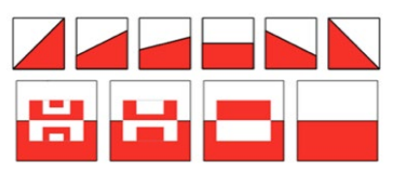
Examples
Finding multiple ways to solve a problem:
Halving
This activity supports the concept of equal areas.
The examples shown, to divide the area of a square into 2 equal areas can be easily understood.
Our task is to figure out more ways in which the area of the given square can be divided in to areas other than these.

Slide 11
Examples
2. Ask their own questions:
Got It
This is a game for 2 players. Start with the target number 23.
The first player chooses a number from 1 to 4. Then the other player adds a number from 1 to 4 to the first player’s number.
Players take turns to add numbers from 1 to 4 to the running number.
First player to reach 23 wins the game!

Slide 12
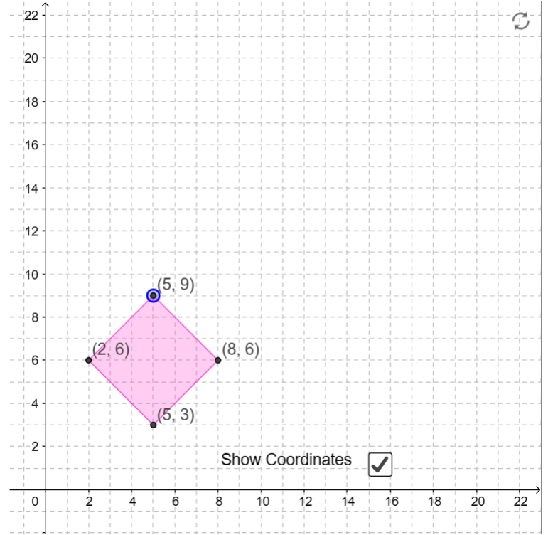
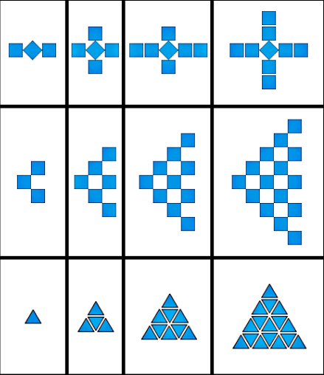
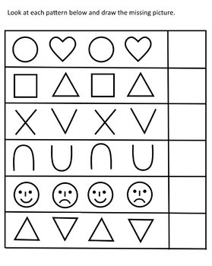
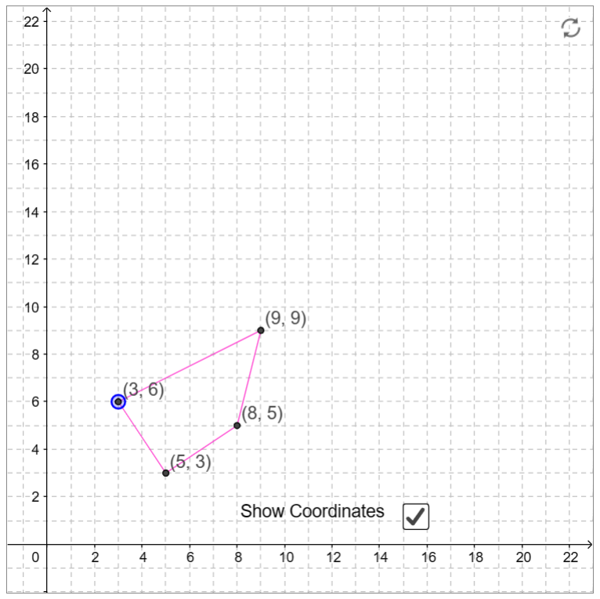
Examples
Discover relationships:
Coordinates of Numbers
This interactive task allows students to play around with the characteristics of squares, using visual clues initially.
The idea is that the coordinates of a square fit in a pattern and that there is a certain relationship between the coordinates of all 4 vertices.
Lets play a game : https://nrich.maths.org/10733

Slide 13
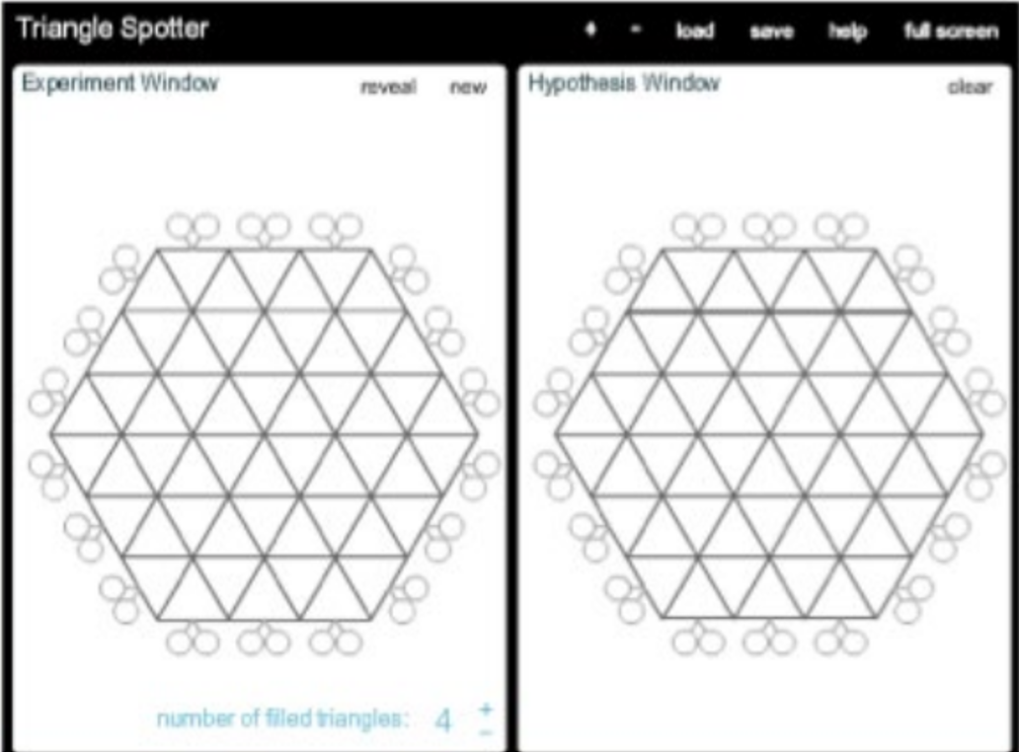
Examples
4. Conjecture about making changes:
White Box
The White Box contains a number of filled triangles.
The task is to find the number of filled triangles in the grid.
Rays can be fired into the box, some will pass straight through the box and some will be deflected by the triangles

Slide 14
Thank You
GLA UNIVERSITY
23/01/2023
Sources: nrich.maths.org, wikipedia.org

